Slide 1
X2AJ2A
LPDDR4 bump/package/ SI/PI
Evaluation Summary

Slide 2
Outline
Product Requirement/Spec.
Design Check with IP vendor (Synopsys)
ref. design flow for RDL/package/PCB design
the info. of test chip
If DDR4/LPDDR4 can share the same substrate design
pin map of LPDDR4/DDR4 check
Substrate/package review
DDR subsys GDS review
SI review
PCB layout review
SI Simulation by ASE
Internal Review Meeting

Slide 3
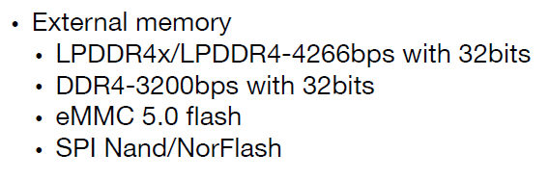
Product Requirement/Spec.
Quote from Doc. “X2AJ2A PRD 1.3.pdf”

Slide 4
Design Check with IP Vendor (Synopsys) -1.1
03/27/2019
[Question]
We are planning to do the RDL, package and PCB design for our chip. Could you please send us the reference design flow for LPDDR4x RDL/package/PCB design?
[Response]
Please go to SNPS DWDL, where we provided several app notes to help customer to use this DDR PHY. Below documents should be useful for you. https://www.synopsys.com/dw/ipdir.php?c=dwc_lpddr4x_multiphy_tsmc16ffc18 DesignWare Cores LPDDR4x multiPHY Implementation Guide DesignWare Cores LPDDR4x multiPHY Interconnect Signal and Power Integrity Guidelines DesignWare Cores Power Integrity and Supply Impedance Determination for DDR …
[Question]
I think there are some guidelines in this package, but I need the reference design flow or sample layout.
Please help to confirm if you're requesting the reference design for dwc_lpddr4x_multiphy_tsmc16ffc18.
[Response]
04/08/2019
Please get the attached package & PCB example design for LP4x mode. Please also get below disclaimers.
******************************************************************************* CONFIDENTIALLY DISCLAIMER ******************************************************************************* THE PROVIDING MATERIAL IS CONFIDENTIAL AND IS BEING DISCLOSED PURSUANT TO THE AGREEMENT UNDER WHICH YOUR EMPLOYER HAS LICENSED THE SYNOPSYS PRODUCT(S) REFERENCED HEREIN. THE INFORMATION BEING DISCLOSED MAY BE USED ONLY AS PERMITTED UNDER SUCH AGREEMENT. ******************************************************************************* WARRANTY DISCLAIMER ******************************************************************************* THIS REPORT AND ALL INFORMATION CONTAINED IN THIS REPORT ARE PROVIDED AS IS WITHOUT WARRANTY, INDEMNIFICATION OR SUPPORT OF ANY KIND, AND SYNOPSYS MAKES NO OTHER WARRANTIES EXPRESS, IMPLIED, STATUTORY OR OTHERWISE REGARDING SUCH INFORMATION. SYNOPSYS SPECIFICALLY DISCLAIMS ANY IMPLIED WARRANTIES OF MERCHANTABILITY, FITNESS FOR A PARTICULAR PURPOSE AND NONINFRINGEMENT, OR ARISING FROM A COURSE OF DEALING OR USAGE OF TRADE.

Slide 5
Design Check with IP Vendor (Synopsys) -1.2
[Question]
There is only layout file in this package, it’s hard to understand your design. Could you please also provide the schematic files for package and PCB design?
Please get the attached Schematics.
04/10/2019
[Question]
Just double confirm with you if the LPDDR4x test chip can reach 4266Mbps?
[Response]
“The new test chip for the automotive grade 2 product was releases to TSMC for fabrication in early April. This IP along with the testchip and its package was redesigned to improve the overall signal integrity to improve performance at 4267 Mbps specifically for LPDDR4X“.
[Question]
According to your information, I think the previous version of test chip have some signal integrity issues. Am I right? Can you provide the latest version of RDL/package/PCB design to us for a reference?
[Response]
Firstly, Please do not think “the previous version of test chip have some signal integrity issues”, that is not the right way to look at it. We had a standard package and PCB designed for LPDDR4-3200, then re-used for LPDDR4-4267 and then re-used for LPDDR4X-4267. As it turned out, specifically for the LPDDR4X multiPHY 16/12FFC test chips, the combination of all that represented a challenge at 4267Mbps for LPDDR4X (LPDDR4-4267 is OK). So yes, with this new AP test chip, we took an opportunity to improve the signal integrity of the package and PCB.
04/23/2019

Slide 6
Design Check with IP Vendor (Synopsys) -1.3
[Response]
From SI and interconnect design point of view, what has been shared with you can still serve as reference for your package and PCB interconnect design. Here are Key considerations for customer implementation based on recent explore with test chip package/PCB, for your reference: 1. need to have very good crosstalk control on both package and PCB. D551 and EB600 are good reference for that. --On package it means stripline routing, good crosstalk control at die bump breakout area with potential crowding, generous signal to power/ground reference core via ratio especially thick substrate, generous signal to power/ground BGA pad ratio. --On PCB: stripline routing, short vias much preferred for DQ as most crosstalk come from vertical interconnect -- this means DQ are routed on layer close to top side. If lower routing layer has to be used, consider using thin PCB if possible. If thick PCB/long vias have to be used, very generous S/G via ratio is probably required which implied that BGA ball map has to be enable that. 2. Need good control on reflection and ISI: -- 40 ohm or lower impedance for DQ. Both D551/EB600 are designed with 50 ohm trace impedance and we have seen improvement in simulation if that is dropped to 40 and below, especially PCB side since package usually very short. --need to watch for return path discontinuity on both package (breakout area) and PCB (reference plane around BGA breakout). Large through hole via on PCB can generate voids on reference plane that disrupt signal return. --need to watch for via stub if DQ routed on upper layer with short depth to minimize via crosstalk. Blind vias/via in pad should be considered for ease of breakout and also elimination of via stub. 3. In general CA has quite a bit more margin compared to DQ so routing resource/priority need to be given to DQ, e.g., on PCB, DQ should be routed close to top side with preferably blind vias, whereas CA can be on lower layer with long vias and higher crosstalk.
06/17/2019
[Question]
There are two more questions about your test chip. 1. Could you please let us know if the shape of DDR PHY is L shape in your test chip? 2. Could you please let me know the added capacitance value of VDDQ DECAP and VDDQLP In your DDR phy?
06/20/2019
[Response]
Could you please open a new SolvNet for this new topic? This case is used to provide the reference package and PCB design. For other topic, we need a new SolvNet case.

Slide 7
Design Check with IP Vendor (Synopsys) - 2
06/21/2019
[Question]
Based previous discussion (CASE 8001210045 - The reference design flow for LPDDR4x RDL/package/PCB deisgn), you have re-tapeout the testchip early of this year to enhance the performance. and we really appreciate your great support and sharing! There are additional two questions about your test chip. 1. Could you please let us know if the shape of DDR PHY is L shape in your test chip? 2. Could you please let me know the added capacitance value of VDDQ DECAP and VDDQLP in your DDR phy?
[Response]
07/02/2019
The test chip, to validate the dwc_ap_lpddr4x_multiphy_tsmc16ffc18_2.00a, was taped out in early April. It is not due back in house until late July, 2019. It's floorplan is not an L-shape. I am attaching a .png here showing its floorplan. I will have to follow up with the decoupling we used but it is specific to our package design. The customer should do a complete power and signal integrity analysis for their own SOC implementation. Our floorplan has the dbytes intentionally spaced far from the master to reflect larger clock routes. A preliminary TC report will be available in late September, early October and a full report currently is planned for mid November, 2019.

Slide 8
Design Check with IP Vendor (Synopsys) - 3
06/24/2019
[Question]
As we checked the DDR bump information that some LPDDR4 bumps are duplicated with DDR4 with different signal requirement, like attached picture shows. As our concern is that the single end requirement shall be 40ohm as your suggestion, and differential shall be 100ohm, not sure how to balance it, pls kindly support to check if DDR4/LPDDR4 can share the same substrate design, thanks
[Response]
Short answer is that they need to explore such kind of trade off by running simulation. Long answer: 1. In LP4x mode, 40 ohm single ended should be coupled with about 80 ohm differential impedance, not 100 ohm. Should be checked in SI run. 80 ohm may help on ringing on DQs/CK, and more balanced with DQ/CA signals. 2. DQ trace impedance more critical compared to CA as CA runs at single data rate and more timing margin. 3. PCB trace impedance is more critical as it is usually much longer than package trace. 4. LP4x 4267 DQ byte lane has tightest margin so should be given higher priority when they do optimization and design trade off.
[Question]
Have checked internal, it’s sad that we try to ask for your service but the timeline is not so matched, can you take a brief list to us? Thanks.
Synopsys provided SI training material on 07/09/2019

Slide 9
Design Check with IP Vendor (Synopsys) - 4
06/25/2019
[Question]
Could you please help us to confirm the Pin map about DDR4/LPDDR4/LPDDR4x in attached file. Our PHY define is ac10d4ch2 and we need support DDR4/LPDDR4/LPDDR4x. And Table 4-11 in LPDDR4x multiPHY Utility Blcok (PUB) Databook version:2.41a, How to calculate the DQB{(8*(DBYTE-4)+7}-DQB{(8*(DBYTE-4))} in ac10d4ch2 ?
[Response]
If using ac10d4ch2, the BP_D[*] to DQB will be as following: BP_D[(DBYTE*12)+7:(DBYTE*12)] ==> DQB{(8*(DBYTE-2)+7}-DQB{(8*(DBYTE-2))}, where DBYTE will be 2, 3 for LPDDR4 CH2. Example: BP_D[24] ==> DQB[0] BP_D[25] ==> DQB[1] BP_D[26] ==> DQB[2] … BP_D[31] ==> DQB[7] BP_D[32] ==> DMB/DBIB[0] BP_D[33] ==> DQSB_T[0] BP_D[34] ==> DQSB_C[0] BP_D[36] ==> DQB[8] BP_D[37] ==> DQB[9] BP_D[8] ==> DQB[10] … BP_D[43] ==> DQB[15] BP_D[44] ==> DMB/DBIB[1] BP_D[45] ==> DQSB_T[1] BP_D[46] ==> DQSB_C[1] The PHY also support DQ remap using CSR register Dq< N>LnSel, e.g. Dq0LnSel: ~~~~ PUB databook, Dq0LnSel, Supports mapping of PHY dq to dram dq within a byte (swizzle). Intended to undo the swizzle of board-level phy-to-dram connections such that MRR operations of binary counters may be return correct values. Note that this register is per-dbyte such that the swizzle may be different per dbyte. Each register in a byte's set of DqLnSel must have a unique value within the set For example, if, on this dbyte, PHY lane 3 is connected to memory dq0 (on this dbyte), then Register Dq0LnSel for this dbyte should be 3.
[Response]
We confirmed internally that in d4 configure, when supporting 2 16b devices, the DRAM on channel B should be connected to "DBYTE-2", not "DBYTE-4". We've been following up internally to have the correct description on Table 4-11, PUB databook.

Slide 10
Design Check with IP Vendor (Synopsys) -5.1
08/14/2019
[Question]
Attachments are layout files and SI result about DDR, pls kindly support to review them, and pls kindly advise if any items need to be improved or modified, thanks a lot
Please fill attached excel for Page:General, Package, PCB and SI_Simulations. We will start each review after receiving the complete information on each one. - General: 5, "SSTL IO" is not applicable for LPDDR4x multiPHY.
Package, PCB and SI report review, we treat these as 3 separate reviews,
[Response]
We have completed package and PCB review in advanced. In order to better track customer reviews in SolvNet system, this case will be used to deliver package review result as attached. ~~~~ Summary: • Microstrip routing on layer CU-1: NOT recommended for data rates above 3200 Mbps • Layer CU-1: Long parallel routing section with 15um line / 15 um space. Height above reference plane is 30 um. Recommendation is 2H spacing (60 um). - Potential crosstalk area. Need to be model extracted and simulated to determine impact of crosstalk. • Layer CU-1 with CU-2 On: Some DDR traces not route above a solid reference plane. - Potential ISI issue. - Potential Crosstalk hot spot • Layer CU-3: “Long” parallel routing section with 15 um line width & 15 um spacing. Height above / below reference plane is 30 um. Recommendation is 2H spacing (60 um). - Potential crosstalk area. Need to be model extracted and simulated to determine impact of crosstalk • Layer CU-4: Not a lot of VSS core vias within the signal via field. - Potential crosstalk issue. Needs to be model extracted and simulated • Layer CU-4: Zoom in on Power section - Concern: the VSS core vias are to the outside of the power planes. This will increase the loop inductance. - What is the loop inductance of these power nets? • Layer CU-8: - Recommendation: A better distribution of the Ground and Power balls within the signal ball field will reduce the overall crosstalk.
08/29/2019

Slide 11
Design Check with IP Vendor (Synopsys) -5.2
Created SolvNet case on behalf of customer. This case will be focus on SI review.
09/02/2019
Per con-call discussion update this case, pls kindly support to share de-coupling value calculate method (maybe the total value include PHY+IP+RTL etc.?) for us reference which showing at SI checklist, thanks a lot.
10/07/2019
[Response]
In the SI simulation checklist, Item 3.1.3 "On-die decoupling capacitance value considered considering all SSTL IO cells, snapcap cells and/or any other decap". (1) VDDQ-VSS decaps can be provided from ACX4/DBYTE/MASTER and dwc_ddrphy_decapvddq_< ew/ns>: - The effective capacitance for each dwc_ddrphy_decapvddq_* can be found in Section 4.7.1, PHY databook. - The effective capacitance for ACX4/DBYTE/MASTER can be found in Section 4.7.2, PHY databook. The total VDDQ-VSS decap can be calculated using: VDDQ decap values = < total number of decapvddq in your floorplan> x < decapvddq effective capacitance, Section 4.7.1, PHY databook> + < number of ACX4> x Cdie(ACX4) + < number of DBYTE> x Cdie(DBYTE) + Cdie(MASTER). (2) VDDQLP-VSS decap can only be provided from dwc_ddrphy_decapvddqlp_< ew/ns>, hence calculation will be as following: VDDQLP decap values = < total number of decapvddqlp in your floorplan> x < decapvddqlp effective capacitance, Section 4.7.1, PHY databook> VDD decaps are inserted and provided from your backend flow.
10/08/2019
To be clear, "SSTL IO cells" is not applicable to your DDR PHY, this was used in Synopsys legacy PHYs like DDR3/2PHY, DDR4 multiPHY, etc. The LPDDR4x multiPHY has embedded IO cells inside ACX4/DBYTE/MASTER, no separate IO cell.
In our design ,the DDR phy and DDR ctrl uses same 0.8V “VDD_DDR” power supply at the chip level. For SI simulation, I think the total capacitance for VDD_DDR domain should contain the VDD decap (which is inserted by backend flow) and the effective capacitance of all logic instances (such as standard cells, memory … ). Is it correct?
All ACX4s and DBYTEs are all in VDD domain, part of MASTER will be in VDD domain. The VDD decap inside ACX4, DBYTE and MASTER should be considered as 0. Hence all VDD decap will come from your backend insertion.

Slide 12
Design Check with IP Vendor (Synopsys) -6
08/16/2019
The GDS of DDR subsys is as attached, please help to review.
More detail information for GDS review is as follows: 1) GDS file (Preferred but optional for FP/BUMP reviews): - Needs to include Hard macro MIPLAST layer with text (inclusion of all Hard Macro layers is preferred) - Should have RDL bump text 【HORIZON】:Yes, we have already merge the GDS of hard-macros. And the GDS have AP_PIN at Bump on top level as well. *2) Technology/process and DDRPHY version (PHY version required, PUB version optional); (Example: dwc_ddr43_phy_tsmc16ffc18 PHY Version 1.00) 【HORIZON】: PHY version: dwc_ap_lpddr4x_multiphy_tsmc16ffc18. version:2.00a. *3) SOC Metal stack: (Example: 9M_2Xa1Xd_h_3Xe_vhv_2Z) 【HORIZON】9M_2Xa1Xd_h_3Xe_vhv_2Z *4) Package type: (Example: FCBGA) 【HORIZON】:FCBGA *5) All PHY configurations: (Example: ac12d10ch1, NS and/or EW) 【HORIZON】:ax10d4ch2 NS *6) List all DDR SDRAM application scenarios: (LPDDR4-3200Mpbs, etc.) 【HORIZON】:LPDDR4X-4266Mpbs 7) Is the GDS DRC & LVS clean? (GDS review only item) 【HORIZON】:The LVS is clean, and there are a little DRC violations on digital block routing. 8) Is this a preliminary, or final review? (GDS review only item) 【HORIZON】:final *9) What is the Target Tape Out date? 【HORIZON】:2019-09-30
[Response]
08/29/2019
We've completed GDS review in advanced, full GDS review report is attached. GDS file name: wuliegg_20190818_193741114_ddr_subsys_pwr_wrap.merge.gds.gz ~~~~ Summary • Must Fix – PHY MTOP 1 PG continuous from Pub to Hard Macros – BP_ZN_SENSE MTOP 1 Sig connection in Master • Recommended Fix – PHY MTOP PG continuous from Pub to Hard Macros • Check Required – The total amount of decap required must be determined through PDN analysis by the customer – Verify Sig RDL meets max RC – Special Nets routing (VrefGlobal and PwrOk ) Max R < 50 Ohm • Meets Requirements – Pclk* Routing

Slide 13
Design Check with IP Vendor (Synopsys) -7.1
09/02/2019
Internal Note 46754 - Package review 46756 - PCB review 46757 - SI report review
[Response]
May you please answer the questions below for the SI report review? ~~~~ 1. Are the power pins of IBIS models exposed to connect PDN model and to measure PDN noise? 2. All the bytes results are simulated in one instance? It is important to do so, to allow maximum transient current from power rail. 3. The eye diagrams from simulations are passing JEDEC requirement as shown and have good margin. But it seems the effects of PDN are not considered. 4. By looking at package design file, there are no decoupling capacitors for VDDQ. 5. On die, capacitance is 3.6nF. I assume it is for VDDQ, which is on lower side from our experience. 6. Is there any PDN analysis performed by Horizon based on current profile (PWL files from Synopsys)? 7. Looking at PDN solution, from our experience it should have more noise on VDDQ when all the lanes are instantiated at the same time.
Pls refer attachment: 1. We used following models, are these ibis models including power pins? [企业微信截图_15674164247651] 2. Not in one instance, how about your suggestions numbers of bytes? 3. Have considered 4. Right, there is no decoupling in the package design 5. Okay, understand it 6. We accorded your PWL to come out the current profile to perform PDN analysis 7. What’s “All lanes” referred to?

Slide 14
Design Check with IP Vendor (Synopsys) -7.2
[Response]
1. We used following models (snapshot is attached), are these ibis models including power pins? Ankit :- Yes, these models include power pins and the PDN models needs to be connected to power pins of IBIS models. Yafen: Got it, thanks 2. Not in one instance, how about your suggestions numbers of bytes? Ankit :- In one instance, all the bytes needs to be simulated, since that will be the worst case operating scenario when all the bytes are writing to memory. Yafen: actually, we simulated all bytes but not using the same logic in pattern. 4. Right, there is no decoupling in the package design Ankit :- Is there any target impedance analysis done for the system? You can refer the app note from Synopsys "Power Integrity and Supply Impedance Determination for DDR Interfaces", to design the PDN for system. Yafen: OK, got it, the data for you reviewing is according “DWC LPDDR4X multiPHY Signal Integrity Application Note” to design the PDN for system, but now we are confusing by the ripple data, its value is different with which defined in “Power Integrity and Supply Impedance Determination for DDR Interfaces” 6. We accorded your PWL to come out the current profile to perform PDN analysis Ankit :- Can you please provide results from PDN analysis? We need more details for that. Yafen: Pls kindly refer to attachment, we are confused by VDDQLP portion, pls support to check it, thanks 7. What’s “All lanes” referred to? Ankit :- All lanes means all the data lanes are having simultaneous activity and that should be captured in simulations. Yafen: Got it, is “all the data lanes are having simultaneous activity” referred to all bytes using the same logic in pattern? Thanks

Slide 15
Design Check with IP Vendor (Synopsys) -7.3
[Response]
Please see feedback from Synopsys SIPI team: ~~~~ From the report ( 20190905031725_PDN information.pptx) it is not very clear how the PDN simulation is done. Q1) What is the stimulus provided for the PDN transient analysis? Please refer to the document: PI_Customer_Training_PDN_analysis_DDR43LPDDR4v2_20180420.pdf. This document explains everything about the PDN analysis. Please consider the points below. 1) For an LP4X interface, we do not think the system will work without having any de-caps in the Package and PCB. Decaps should be provided for VDDQ, VDDQLP and VDD. 2) Did you get the DIE current PWL profiles to determine the Z_target? This can be generated from PHY_Compiler tool or upon request to Synopsys. 3) From the DIE current PWL, create the worst case pattern by inserting NOPs in between (refer to PI_Customer_Training_PDN_analysis_DDR43LPDDR4v2_20180420.pdf) to get the worst case ripple for the PDN. 4) Check for the worst case ripple and see if it is within the specification 5) SI simulation needs to be performed with all DQs & CA signals and PDN needs to be excited with the worst case stimulus. 6) Check for the margin in Timing budget table 7) Check for the CK jitter
09/18/2019
Q 1) we provided random seed to perform the PI simulation, attachment is the seed we used for you reference: Please consider the points below. 1) For an LP4X interface, we do not think the system will work without having any de-caps in the Package and PCB. Decaps should be provided for VDDQ, VDDQLP and VDD. Ans: Received this information, could you support to check the risk level which without de-caps in package? From current simulation data, it seems it can work, thanks for any feedback. 2) Did you get the DIE current PWL profiles to determine the Z_target? This can be generated from PHY_Compiler tool or upon request to Synopsys. Ans: Yes, upon request Synopsys. 3) From the DIE current PWL, create the worst case pattern by inserting NOPsin between (refer to PI_Customer_Training_PDN_analysis_DDR43LPDDR4v2_20180420.pdf) to get the worst case ripple for the PDN. Ans: Okay, we are studying the file 4) Check for the worst case ripple and see if it is within the specification Ans: Will following the specification of Case 8001256671 5) SI simulation needs to be performed with all DQs & CA signals and PDN needs to be excited with the worst case stimulus. Ans: Yes, be performed with all DQs and CA signals, but not with the worst case stimulus I think. 6) Check for the margin in Timing budget table 7) Check for the CK jitter

Slide 16
Design Check with IP Vendor (Synopsys) -7.4
[Response]
09/26/2019
A 1) we provided random seed to perform the PI simulation, attachment is the seed we used for you reference. [SNPS] The DIE current PWL should be swept in such a way that it will hit the PDN resonance peak. Only this will ensure we are running the worst case analysis. It is explained in the PI Customer training document. You have to perform a separate PI analysis to understand the worst case ripple. 1) For an LP4X interface, we do not think the system will work without having any de-caps in the Package and PCB. Decaps should be provided for VDDQ, VDDQLP and VDD. [Horizon] Received this information, could you support to check the risk level which without de-caps in package? From current simulation data, it seems it can work, thanks for any feedback. [SNPS] The amount of de-cap required can only be found through the PI simulation. Package de-caps help us to reduce the PDN resonance peak below the Z_target. Then a timing simulation with the DIE current PWL will tell us the Voltage ripple. The ripple can still be lower if the PDN stimulus (DIE current) is not correct. Make sure the stimulus is hitting the maximum resonance peak of the PDN, so that we will get the maximum ripple. The sign-off needs to be done based on the Jitter analysis and after updating the timing budget tables.
we accept your suggestion, will refer to jitter result for reference, thanks for your support
10/07/2019

Slide 17
Design Check with IP Vendor (Synopsys) - 8
[Response]
08/29/2019
~~~~ Summary: • Microstrip routing on layer CU-1: NOT recommended for data rates above 3200 Mbps • Layer CU-1: Long parallel routing section with 15um line / 15 um space. Height above reference plane is 30 um. Recommendation is 2H spacing (60 um). - Potential crosstalk area. Need to be model extracted and simulated to determine impact of crosstalk. • Layer CU-1 with CU-2 On: Some DDR traces not route above a solid reference plane. - Potential ISI issue. - Potential Crosstalk hot spot • Layer CU-3: “Long” parallel routing section with 15 um line width & 15 um spacing. Height above / below reference plane is 30 um. Recommendation is 2H spacing (60 um). - Potential crosstalk area. Need to be model extracted and simulated to determine impact of crosstalk • Layer CU-4: Not a lot of VSS core vias within the signal via field. - Potential crosstalk issue. Needs to be model extracted and simulated • Layer CU-4: Zoom in on Power section - Concern: the VSS core vias are to the outside of the power planes. This will increase the loop inductance. - What is the loop inductance of these power nets? • Layer CU-8: - Recommendation: A better distribution of the Ground and Power balls within the signal ball field will reduce the overall crosstalk.
~~~~ Summary: • PCB is an eight layer design • SOC Adjacent to DRAM attached directly to PCB • Routing other than DDR routes is not yet complete • Signals are stripline structure, routed mainly on L3 and L6 – This is good to help manage crosstalk – Signals escape the BGA field with short length of microstrip on L1

Slide 18

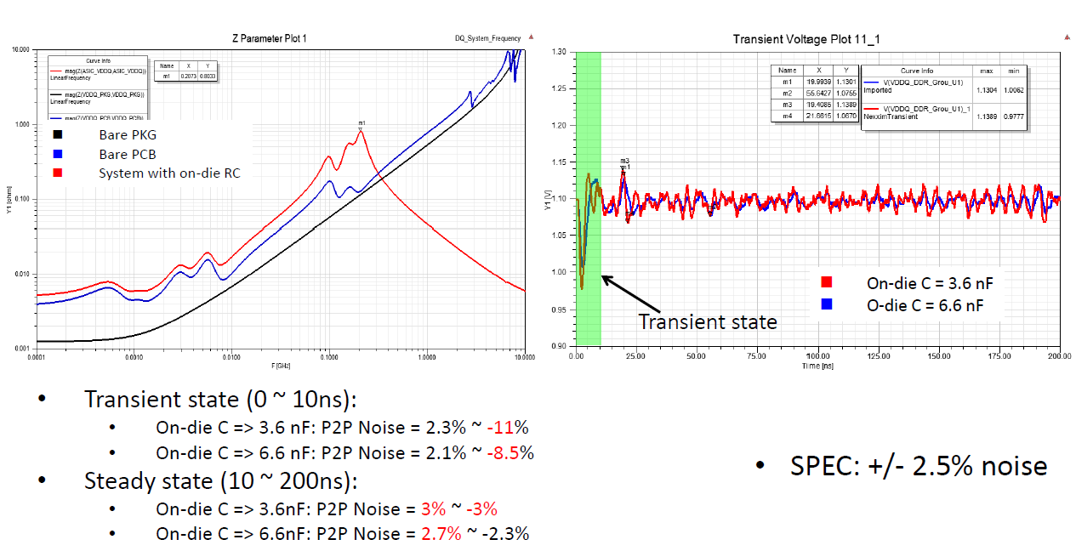
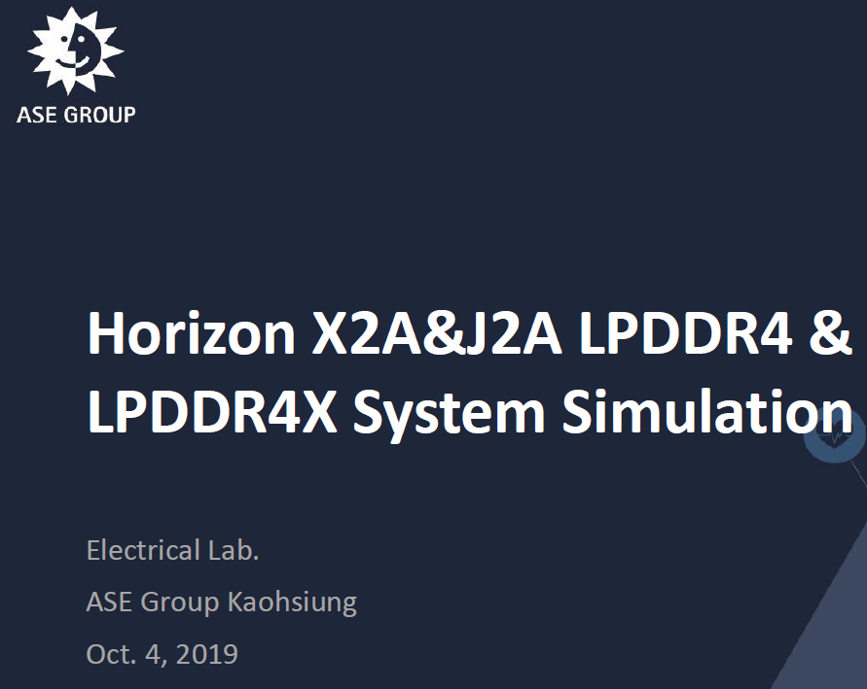

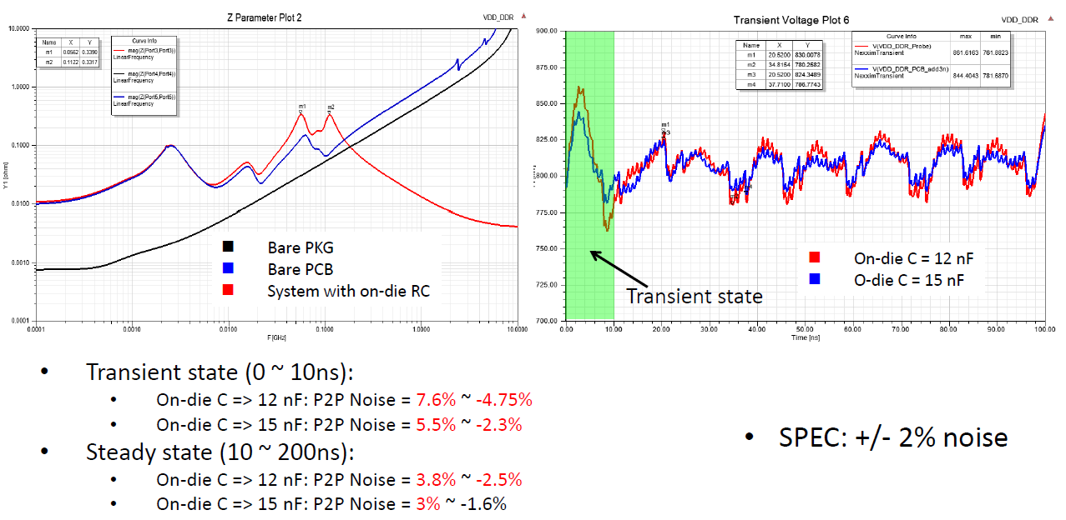
SI Simulation by ASE
http://wiki.hobot.cc/pages/viewpage.action?pageId=61624361

Slide 19
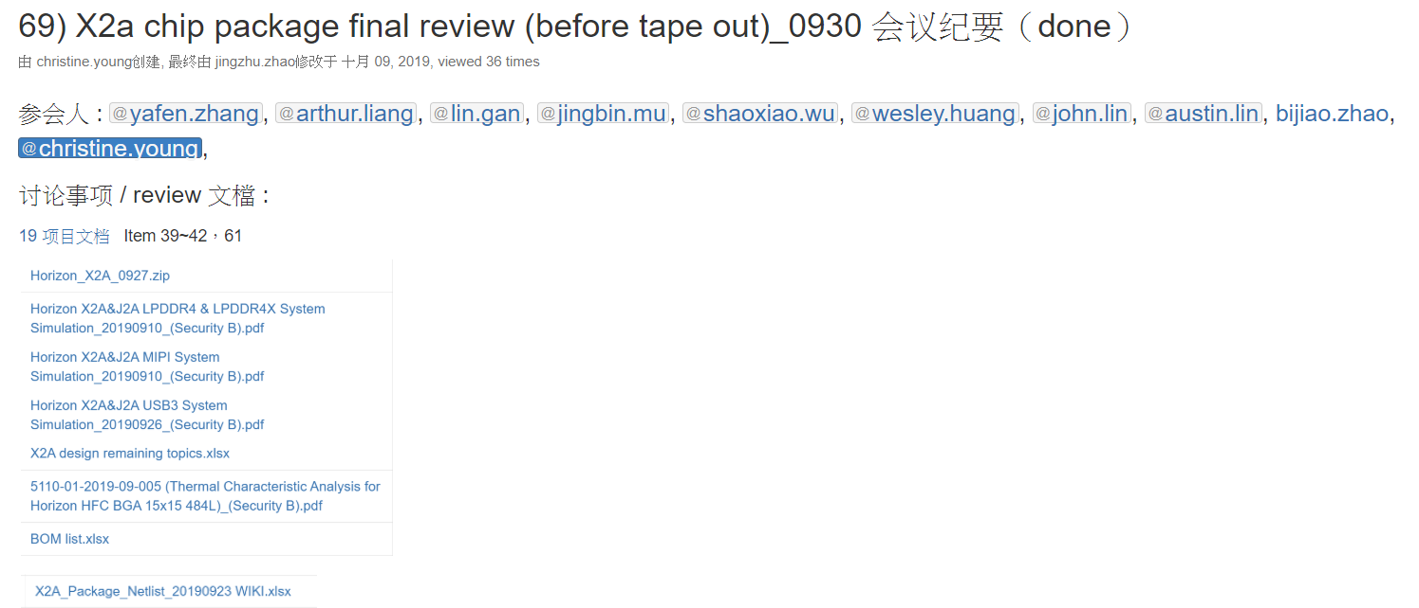
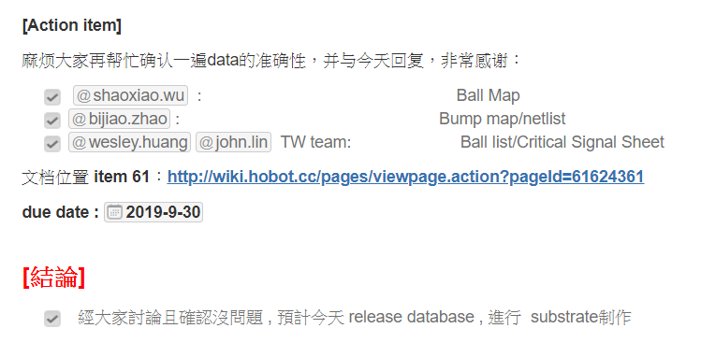
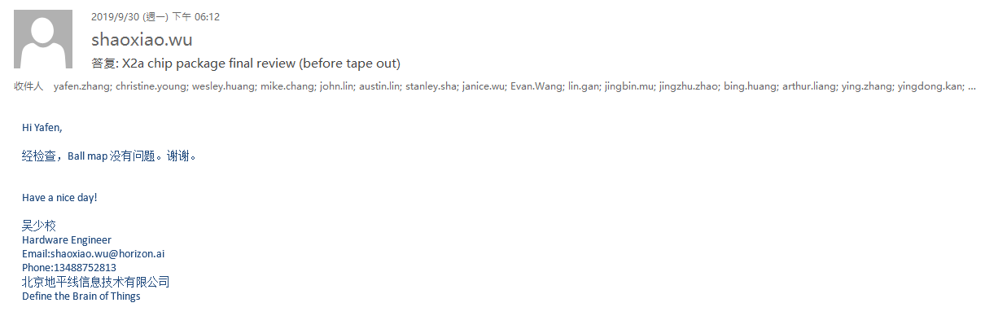
Internal Review Meeting
http://wiki.hobot.cc/pages/viewpage.action?pageId=72460468

